Slide 1
CDC error explanation for design_assignment
16-06-2025
Sharanya Shetty

Slide 2
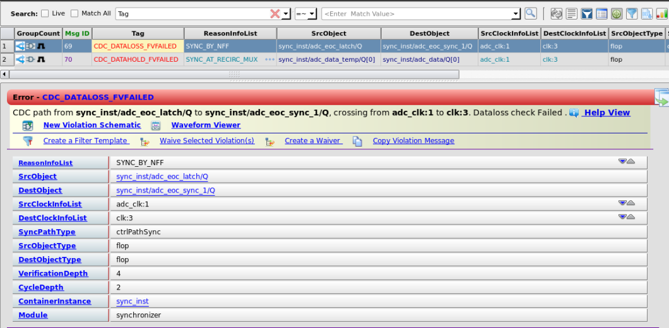
CDC errors
Error:
signal can deassert during destination clock sampling window, violating dataloss requirements for safe CDC transfer.
In our case EOC will be stable for 5 clk cycle and I capture the data before it deassert

Slide 3
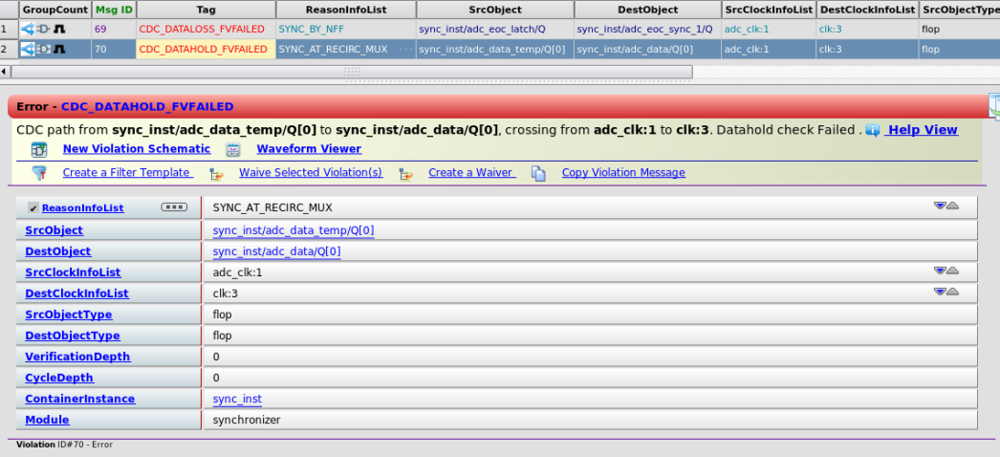
CDC errors
Error:
signal can deassert during destination clock sampling window, violating dataloss requirements for safe CDC transfer.
In our case EOC will be stable for 5 clk cycle and I capture the data before it deassert

Slide 4
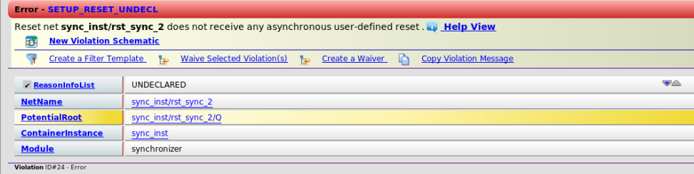
CDC errors
Error: Reset net rst_n_asyn does not receive any asynchronous user-defined reset
This is a CDC tool configuration issue, not a code problem. The tool doesn't recognize rst_n_asyn as the primary asynchronous reset for your design.

Slide 5
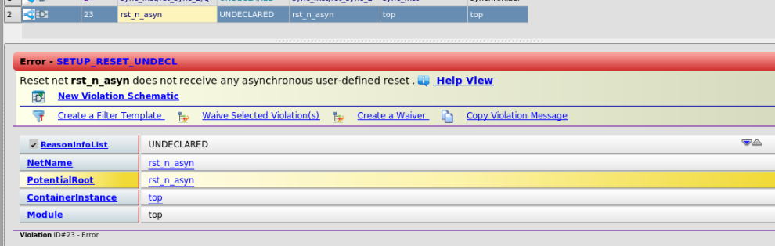
CDC errors
Error: Reset net rst_n_asyn does not receive any asynchronous user-defined reset
This is a CDC tool configuration issue, not a code problem. The tool doesn't recognize rst_n_asyn as the primary asynchronous reset for your design.

Slide 6
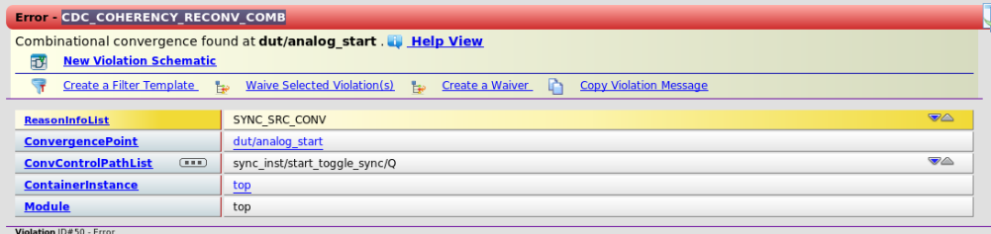
CDC errors
Error: Combinational convergence found at dut/analog_start Code:
assign analog_start = (start_slot || mid_slot) && (((fsm == SINGLE || fsm == IDLE) && analog_1) || (fsm == PAIR && analog_2));
The CDC convergence error can be safely waived because mutual exclusivity fundamentally changes the nature of the convergence. Instead of two independent signals creating potential timing conflicts, you have two representations of a single logical event that cannot occur simultaneously. This eliminates the timing hazard that CDC convergence analysis is designed to catch.

Slide 7
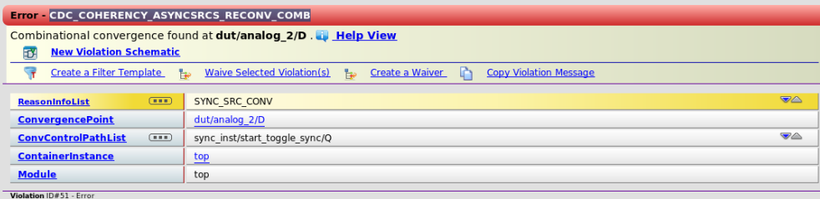
CDC errors
Error: Combinational convergence found at dut/analog_2/D
1. Tool Limitation - Source Domain Tracking
The CDC tool is likely tracking the original source domains:
analog_done originally from ana_clk
mid_slot originally from time_clk
Even though both are properly synchronized to clk, the tool flags them as "different domain signals converging."

Slide 8
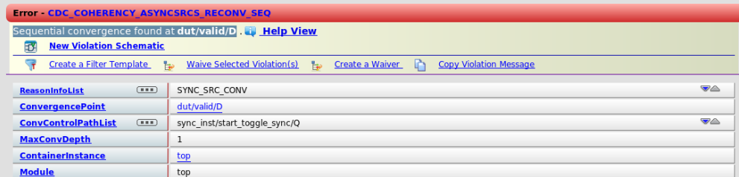
CDC errors
Error: Sequential convergence found at dut/valid/D Code:
always_ff @(posedge clk or negedge rst_n) begin
if (!rst_n) valid <= 1'b0; else if (capture_start && adc_eoc) valid <= 1'b1;
Source Domain Confusion: The tool tracks that:
capture_start has origins in time_clk domain
adc_eoc has origins in adc_clk domain
Synchronization Not Recognized: The tool doesn't properly recognize that both signals are now operating in the clk domain after proper synchronization.

